Slide 1
Fundamentals of Machine Learning
(20B12CS331)
Odd Semester 2022 (5th Semester )
Linear Algebra
Computer Science and Engineering and Information Technology
Jaypee Institute Of Information Technology (JIIT), Noida

Slide 2
Linear Equations
Example 1: House pricing problem
For example, imagine that we are trying to predict house price in Noida
• We have a set of m data.
• Each data contains n features, e.g., no. of rooms, square feet, etc.
• These n features are represented by the vector a = (a1, a2, ..., an).
• The label is house price, which is represented by the scalar b.
The relation between the house features and its price (label) is assumed (inductive hypothesis) to be linear: a.x = b
• Here x is the importance (coefficient or weight) for each feature.
• Then, we get a set of linear equations:

Slide 3
Linear system of equations
For solving this learning problem described in Example 1 of slide 1, there are two issues to be resolved.
• 1) We need to represent this large system of equations compactly.
• 2) We need to develop a technique for solving this linear system of equations (or linear system).

Slide 4
Linear Algebra provides us data structures for representing large arrays of numbers using vectors and matrices.
• Matrix form of this linear systems is:
Ax = b
• Here A is the coefficient matrix and x and b are the vectors.

Slide 5
Data Representation using Matrices
Matrices can be used to store and represent data
In general,
Rows represents the sample records
Columns represent the attributes
A matrix of size m × n is called an m × n matrix.
The elements (or entries or coefficients) of a matrix are the values in the array.
The i, j element is the value in the i^{th} row and j^{th} column, denoted by double subscripts: the i, j element of a matrix A is denoted A_{ij}

Slide 6
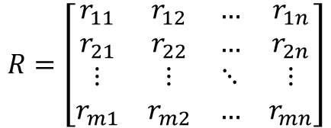
A real life example :
Suppose you need to store the rainfall data of m different locations on n consecutive days.
This can be represented using an m x n matrix R
Rows represent locations
Columns represent consecutive days
R[3,1] is the rainfall data at location 3 on day 1
The jth column of R, which is an m-vector, gives the rainfall at the m locations on day j.
The ith row of R, which is an n-row-vector, is the time series of rainfall at location i.

Slide 7
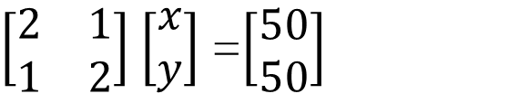
Representation of problems in Linear Algebra
System of Linear equations
Consider a simple problem. Suppose that price of 1 apple & 2 oranges or 2 apples and 1 orange is 50 Rupees. We need to find price of a apple and an orange.
Suppose the price of an apple is Rs ‘x’ and the price of an orange is Rs ‘y’. Values of ‘x’ and ‘y’ can be anything depending on the situation i.e. ‘x’ and ‘y’ are variables.
Matrix View
Let’s translate this in mathematical form –
2x + y =50...........(1)
Similarly, for the second condition-
x + 2y = 50 ..............(2)
The linear equation can be represented as matrix form : Ax=B , where A is the coefficient matrix of size mxn .The m and n are number of equations and variables. B denotes the value in the R.H.S

Slide 8
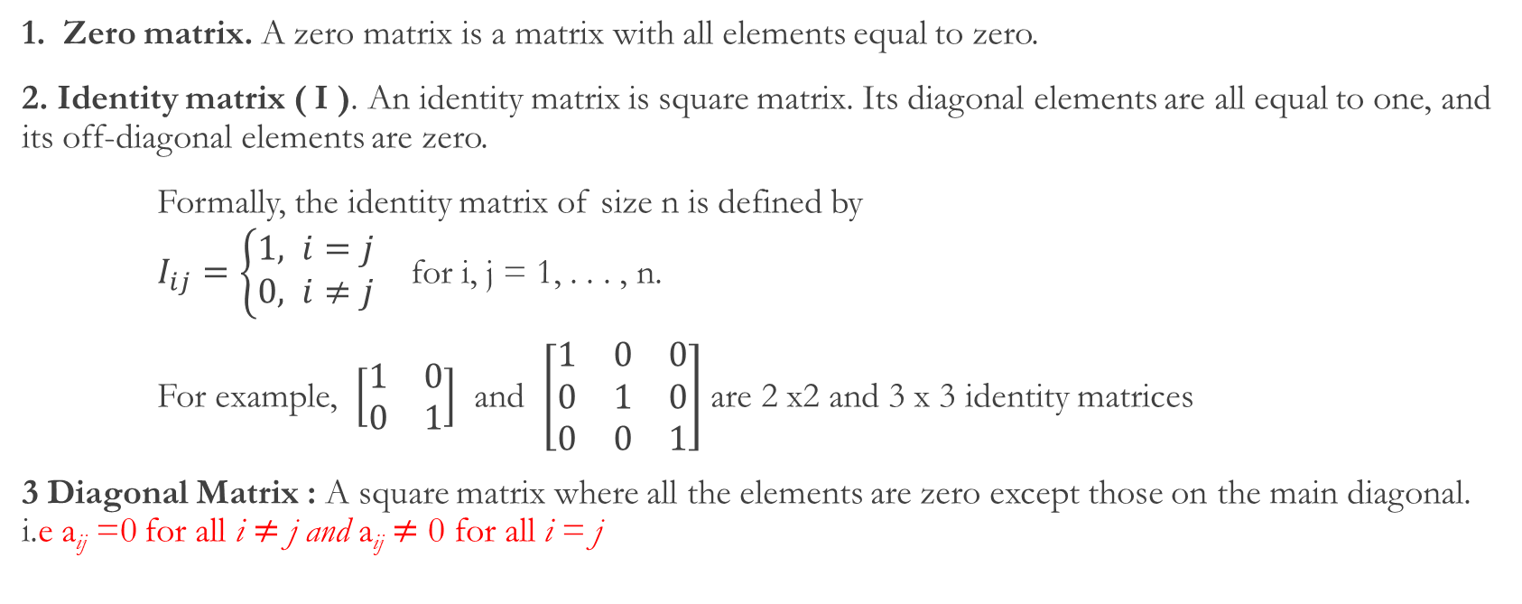
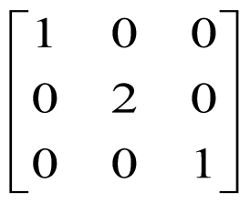
Types of matrices

Slide 9
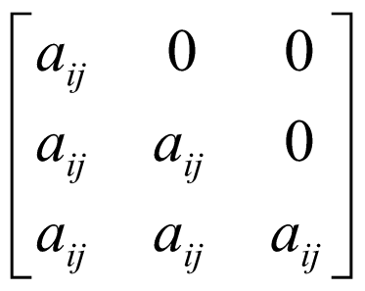
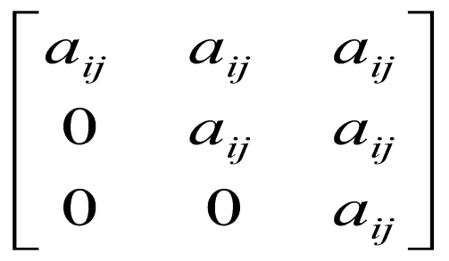
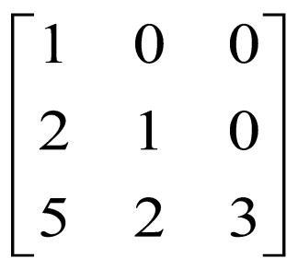
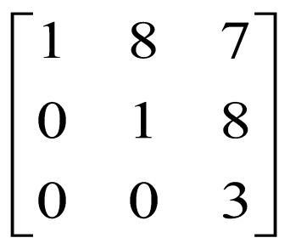
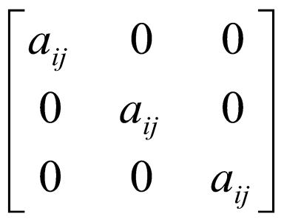
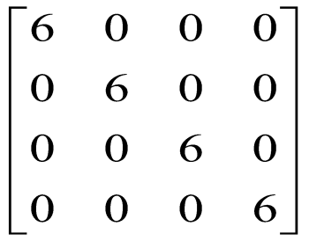
Types of matrices – Contd..
4. Triangular matrices. A square n × n matrix A is upper triangular if A_{ij} = 0 for i > j, and it is lower triangular if A_{ij} = 0 for i < j. If a matrix is either lower or upper triangular, it is called triangular.
For example, the matrices
Lower triangular matrix : i.e. a_{ij} = 0 for all i < j
Upper triangular matrix i.e. a_{ij} = 0 for all i > j
Lower triangular matrix
Upper triangular matrix
5. Scalar matrix
A diagonal matrix whose main diagonal elements are equal to the same scalar.
A scalar is defined as a single number or constant

Slide 10
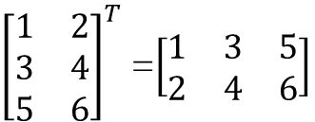
Matrix Operations
Transpose of a matrix
transpose of m × n matrix A, denoted A^{T} or A′, is n × m matrix with
(A^{T} ) _{ij} = A_{ji}
rows and columns of A are transposed in A^{T}
Example
transpose converts row vectors to column vectors, vice versa
(A^{T})^{T =} A

Slide 11

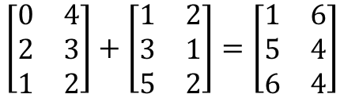

2. Matrix Addition
The sum or difference of two matrices, A and B of the same size yields a matrix C of the same size
Properties of matrix addition
commutative: A + B = B + A
associative: ( A + B) + C = A + ( B + C ), so we can write as A + B + C
A + 0 = 0 + A = A; A − A = 0
( A + B ) ^{T} = A ^{T} + B ^{T}
Example:
matrix subtraction is similar:

Slide 12
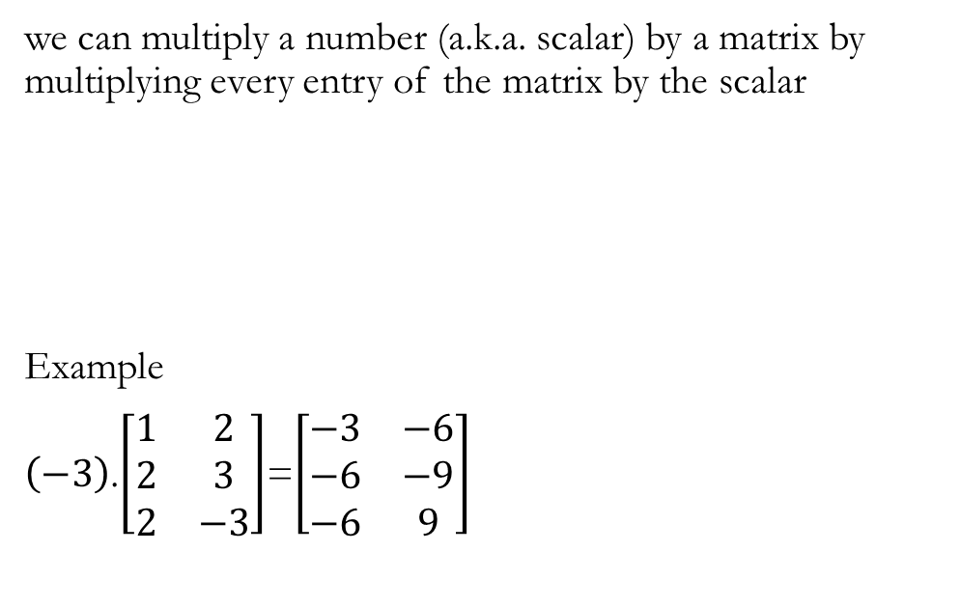
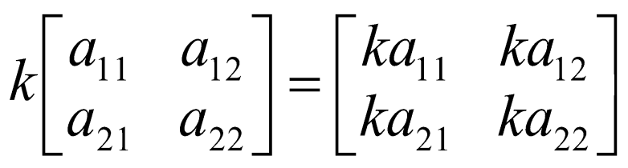
3. Scalar multiplication
Properties of Scalar Multiplication
1.(α + β)A = αA + βA;
2. (αβ)A = (α)(βA)
3. α(A + B) = αA + αB
4. 0 · A = 0;
5. 1 · A = A

Slide 13
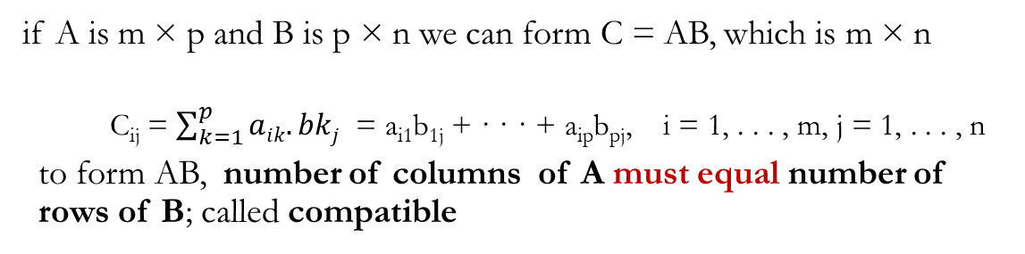

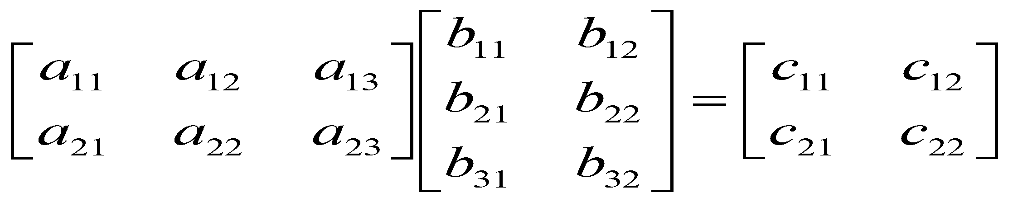
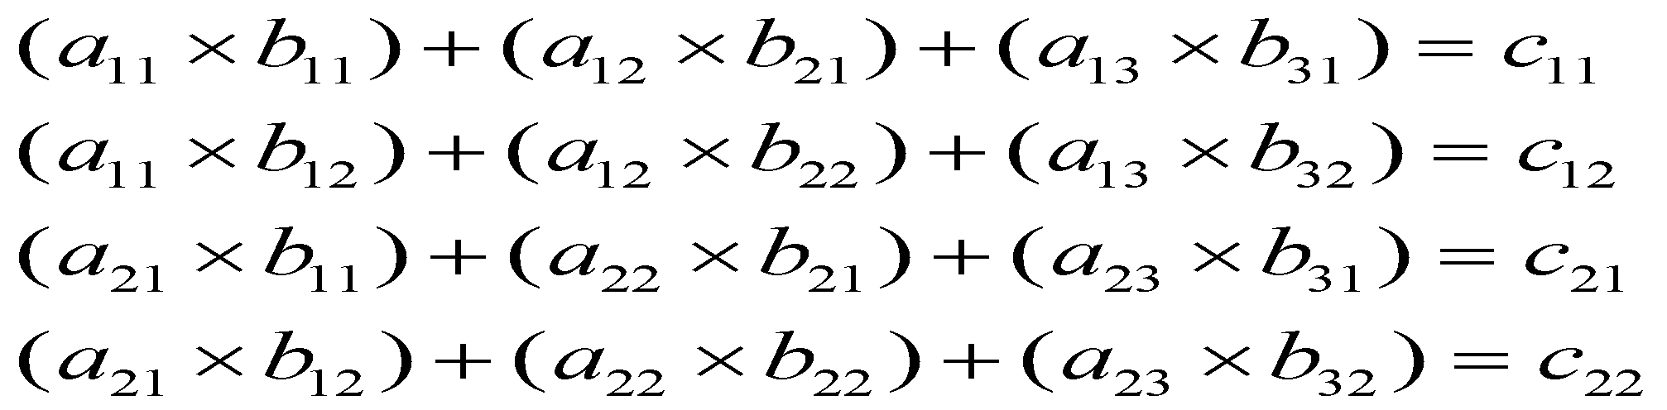
4. Matrix multiplication
Example
Properties
1.0 A = 0, A0 = 0 (here 0 can be scalar, or a compatible matrix)
2. IA = A, AI = A
3.(AB ) C = A (BC ), so we can write as ABC
4. α (AB) = (αA ) B, where α is a scalar
5 A ( B + C) = AB + AC, ( A + B ) C = AC + BC
6. (AB ) ^{T} = B ^{T} A ^{T}

Slide 14
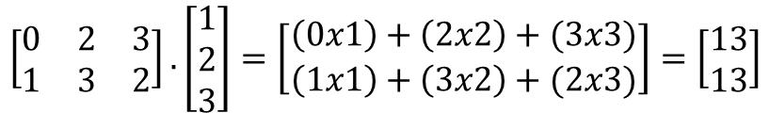
5. Matrix-vector product
If A is an m×n matrix and x is an n-vector, then the matrix-vector product y = Ax is the m-vector y with elements
y_{i} = A_{i1}x₁ + · · · + A_{in}x_{n}, i = 1, . . . , m
Example:

Slide 15

6. Inverse of a matrix
The inverse of a square matrix, A, if it exists, is the unique matrix A⁻¹ where:
AA⁻¹ = A⁻¹ A = I
If the matrix A has inverse, then it is called invertible or nonsingular
if A doesn’t have an inverse, it’s called singular or noninvertible
Inverse of 2 × 2 matrix
General formula for computing inverse of a 2x2 matrix

Slide 16
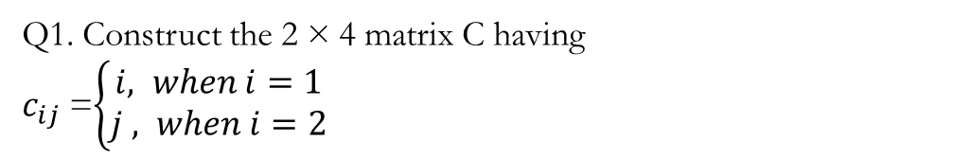
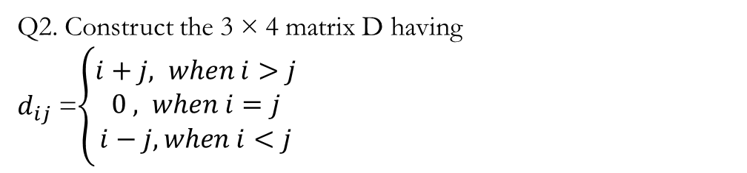
Exercise
Q3. Store 1 of a three store chain has 3 TV, 5 Computers, 3 washing machines, and 4 water heater in stock. Store 2 has in stock no TV, 2 computers, 9 washing machines, and 5 electric heaters, while store 3 has in stock 4 TV, 2 computers, and no washing machines or electric heaters. Present the inventory of the entire chain as a matrix.
Q4. A person purchased 100 shares of Wipro at $27 per share, 150 shares of HP at $45 per share, 50 shares of IBM at $116 per share, and 500 shares of HCL at $2 per share. The current price of each stock is $29, $41, $116, and $3, respectively. Represent in a matrix all the relevant information regarding this person’s portfolio.

Slide 17
Solving Linear system of equations
Linear Algebra also provides us techniques for solving this linear system of equations.
on the left-hand side we are doing some kind of transformation.
This transformation is called linear transformation that satisfies some criteria.
These transformations are typically represented by matrix vector products
Let A be a m x n matrix and x is n x 1 vector. • Then the function T(x) = Ax is a linear transformation from ℝ^{n} into ℝ^{m}

Slide 18
Example
In some Machine Learning problems, input data may have
thousands or millions of dimensions!
• For example, images may have 5M pixels.
• Learning becomes expensive or inefficient!
• One solution is to decrease the complexity of the data.
• But how?
Represent data with fewer dimensions!
• Our assumption is that the essence or core content of a data does not span along all dimensions.

Slide 19
Consider the following example.
• Although x is 2D, it occupies (is alive) only one direction.

Slide 20
Solving Linear System of equations : Ax = b
First we mention (briefly) a general method called Gauss elimination.

Slide 21
An important systematic method for solving linear systems is Gauss elimination and back substitution.

Slide 22
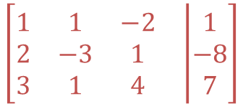
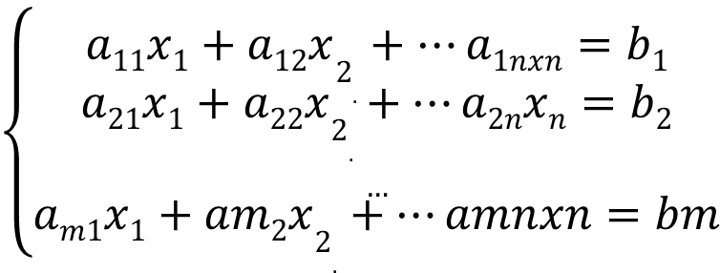
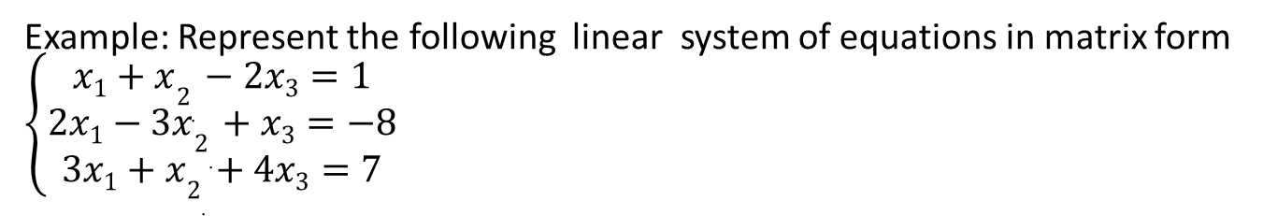
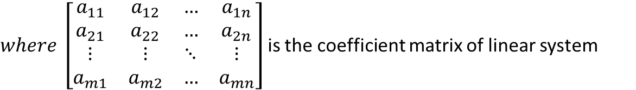
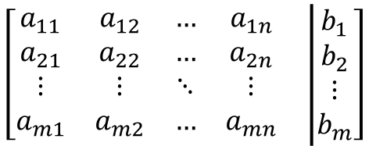
Representation of system of linear equations in matrix form
$$\left\{\begin{aligned}a11x1+a12x2_{.}+…a1nxn=b1 \\ a21x1+a22x2_{.}+…a2nxn=b2 \\ … \\ am1x1+am2x2_{.}+…amnxn=bm\end{aligned}\right.$$
Can be represented as augmented matrix
$$\left[\begin{matrix}\begin{matrix}a_{11} & a_{12} & … & a_{1n} \\ a_{21} & a_{22} & … & a_{2n} \\ ⋮ & ⋮ & ⋱ & ⋮ \\ a_{m1} & a_{m2} & … & a_{mn}\end{matrix} & \left|\begin{matrix}b_{1} \\ b_{2} \\ ⋮ \\ b_{m}\end{matrix}\right.\end{matrix}\right]$$
$where \left[\begin{matrix}a_{11} & a_{12} & … & a_{1n} \\ a_{21} & a_{22} & … & a_{2n} \\ ⋮ & ⋮ & ⋱ & ⋮ \\ a_{m1} & a_{m2} & … & a_{mn}\end{matrix}\right]$ is the coefficient matrix of linear system
Example: Represent the following linear system of equations in matrix form $\left\{\begin{aligned}x1+x2_{.}−2x3=1 \\ 2x1−3x2_{.}+x3=−8 \\ 3x1+x2_{.}+4x3=7\end{aligned}\right.$
$$\left[\begin{matrix}\begin{matrix}1 & 1 & −2 \\ 2 & −3 & 1 \\ 3 & 1 & 4\end{matrix} & \left|\begin{matrix}1 \\ −8 \\ 7\end{matrix}\right.\end{matrix}\right]$$

Slide 23
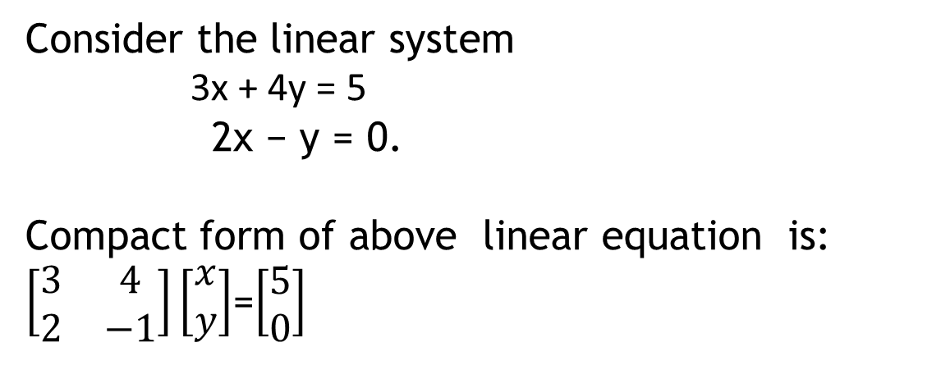
Solving Linear Equations
Every linear system may have only one of three possible number of solutions:
The system has a single unique solution.
The system has infinitely many solutions.
The system has no solution
Consider the linear system
3x + 4y = 5
2x − y = 0.
Compact form of above linear equation is:
$\left[\begin{matrix}3 & 4 \\ 2 & −1\end{matrix}\right]\left[\begin{matrix}x \\ y\end{matrix}\right]$=$\left[\begin{matrix}5 \\ 0\end{matrix}\right]$
m=n | If number of equations is equal to number of variables, then unique solutions
m>n | No solution exists
m<n | More than one solution exists

Slide 24
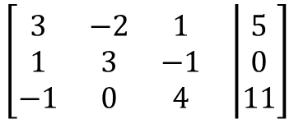
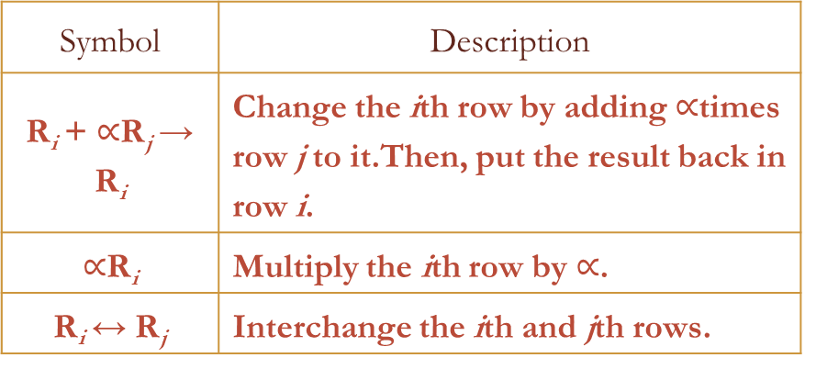
Solving a System of Linear Equations Using Matrices
Step 1 : Represent the linear system of equations in augmented matrix form .
Augmented matrix
$$\left[\begin{matrix}\begin{matrix}3 & −2 & 1 \\ 1 & 3 & −1 \\ −1 & 0 & 4\end{matrix} & \left|\begin{matrix}5 \\ 0 \\ 11\end{matrix}\right.\end{matrix}\right]$$
Symbol | Description
R_{i} + $∝$R_{j}→ R_{i} | Change the ith row by adding $∝$times row j to it.Then, put the result back in row i.
$∝$R_{i} | Multiply the ith row by $∝$.
R_{i}↔ R_{j} | Interchange the ith and jth rows.
Step 2 : Reduce into Row-Echelon form by applying elementary row operations. Three basic row operations are :
interchange two rows (swapping)
Multiply one of the rows by a nonzero constant
Add a multiple of one row to another row.
Step 3: the matrix in row-echelon form is solved by back-substitution. (Gauss elimination method)

Slide 25
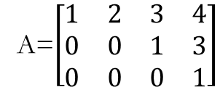
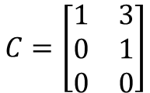
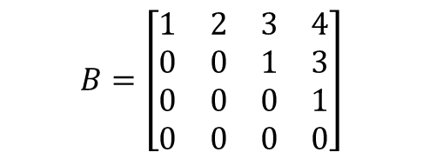
Row Echelon Form (REF)
A matrix is in row echelon form (ref) when it satisfies the following conditions.
The first non-zero element in each row, called the leading entry, is 1.
Each leading entry is in a column to the right of the leading entry in the previous row.
Rows with all zero elements, if any, are below rows having a non-zero element.
Example:
$$B=\left[\begin{matrix}1 & 2 & 3 & 4 \\ 0 & 0 & 1 & 3 \\ 0 & 0 & 0 & 1 \\ 0 & 0 & 0 & 0\end{matrix}\right]$$
A=$\left[\begin{matrix}1 & 2 & 3 & 4 \\ 0 & 0 & 1 & 3 \\ 0 & 0 & 0 & 1\end{matrix}\right]$
$$C=\left[\begin{matrix}1 & 3 \\ 0 & 1 \\ 0 & 0\end{matrix}\right]$$

Slide 26
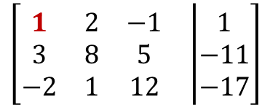
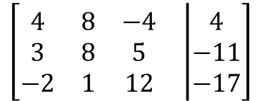
Example : Solution of Linear equations using Gauss elimination method
Step 1: Construct augmented matrix
$$\left[\begin{matrix}\begin{matrix}4 & 8 & −4 \\ 3 & 8 & 5 \\ −2 & 1 & 12\end{matrix} & \left|\begin{matrix}4 \\ −11 \\ −17\end{matrix}\right.\end{matrix}\right]$$
Step 2: convert into Row-echelon form (REF form)
$$\left[\begin{matrix}\begin{matrix}1 & 2 & −1 \\ 3 & 8 & 5 \\ −2 & 1 & 12\end{matrix} & \left|\begin{matrix}1 \\ −11 \\ −17\end{matrix}\right.\end{matrix}\right]$$
$$\frac{1}{4}$$
(R1)

Slide 27
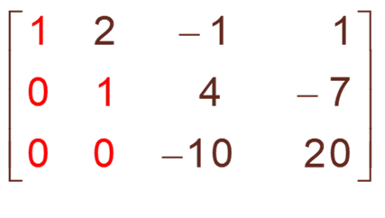
The matrix is now in row-echelon form
Solve using back-substitution. The last matrix represents the following equations
z=-2
Y+4z= -7
X+2y-z=1
Using back-substitution, we obtain the solution as (-3,1,-2)

Slide 28
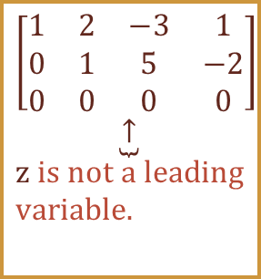
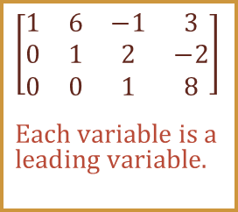
A linear equation may have one of the following possibilities
One solution No solution Infinitely many solutions
$$\left[\begin{matrix}1 & 6 & −1 & 3 \\ 0 & 1 & 2 & −2 \\ 0 & 0 & 1 & 8\end{matrix}\right] \\ \underset{\begin{aligned}&\text{Each} \text{variable} \text{is} \text{a} \\ &\text{leading} \text{variable}\text{.}\end{aligned}}{}$$
Case 1 : One Solution -if each variable in the row-echelon form is a leading variable, the system has exactly one solution. Then find the solution by using back-substitution or other methods
Case 2 : No Solution : If the row-echelon form contains row that represents the equation 0 = c , where c is not zero, the system has no solution.
A system with no solution is called inconsistent.
$$\left[\begin{matrix}1 & 2 & −3 & 1 \\ 0 & 1 & 5 & −2 \\ 0 & 0 & 0 & 0\end{matrix}\right] \\ \underset{\begin{aligned}&\text{z} \text{is} \text{not} \text{a} \text{leading} \\ &\text{variable}\text{.}\end{aligned}}{\underbrace{↑}}$$
Case 3: Infinitely many solution - If the variables in the row-echelon form are not all leading variables, and if the system is not inconsistent, it has infinitely many solutions.
The system is called dependent.

Slide 29
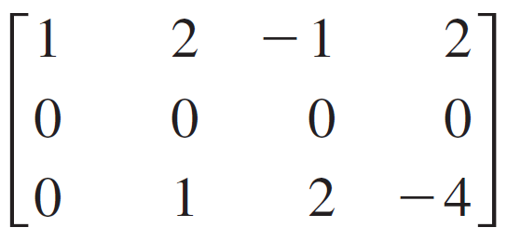
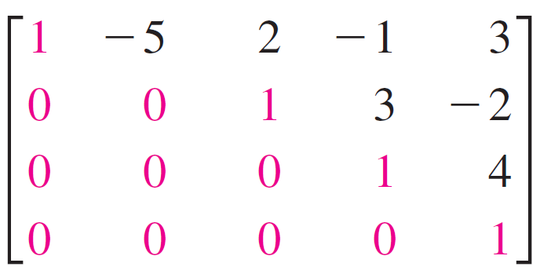
Exercise
1. Determine whether each matrix is in row-echelon form. If it is, determine whether the matrix is in reduced row-echelon form. a. b. c. d.

Slide 30
Exercises
2. Write the augmented matrix for the system of linear equations. x + 3y = 9 –y + 4z = –2 x – 5z = 0 What is the dimension of the augmented matrix?
3. Solve the following system of linear equations using matrices.
−x−2y+z=−12
x+3y=2
y−2z=0

Slide 31
Linear Equations Ax=b
In Machine Learning we concern with solving linear systems in which A is a square matrix.
• For solving this special linear system, we need to compute the inverse of A.
Ax = b
=> x = A⁻¹b
The inverse of A is denoted by A⁻¹ such that AA⁻¹ = A⁻¹A = I (identity matrix)
• If A has an inverse then it is nonsingular.
• The inverse of A exists if its determinant is not zero.

Slide 32
For a nonsingular matrix A, its inverse is computed by using the Gauss-Jordan elimination method.
Example

Slide 34
Solving Linear System of Equations Ax=b
Consider that A is a square matrix and it’s inverse exists (A is non-singular).
• Then, multiplication of the inverse A⁻¹ from both sides results
into a unique solution x for the linear system:
How do we know whether a matrix is non-singular (has inverse or not)?
• If a matrix has inverse, then its determinant should be
non-zero!

